Slide 1

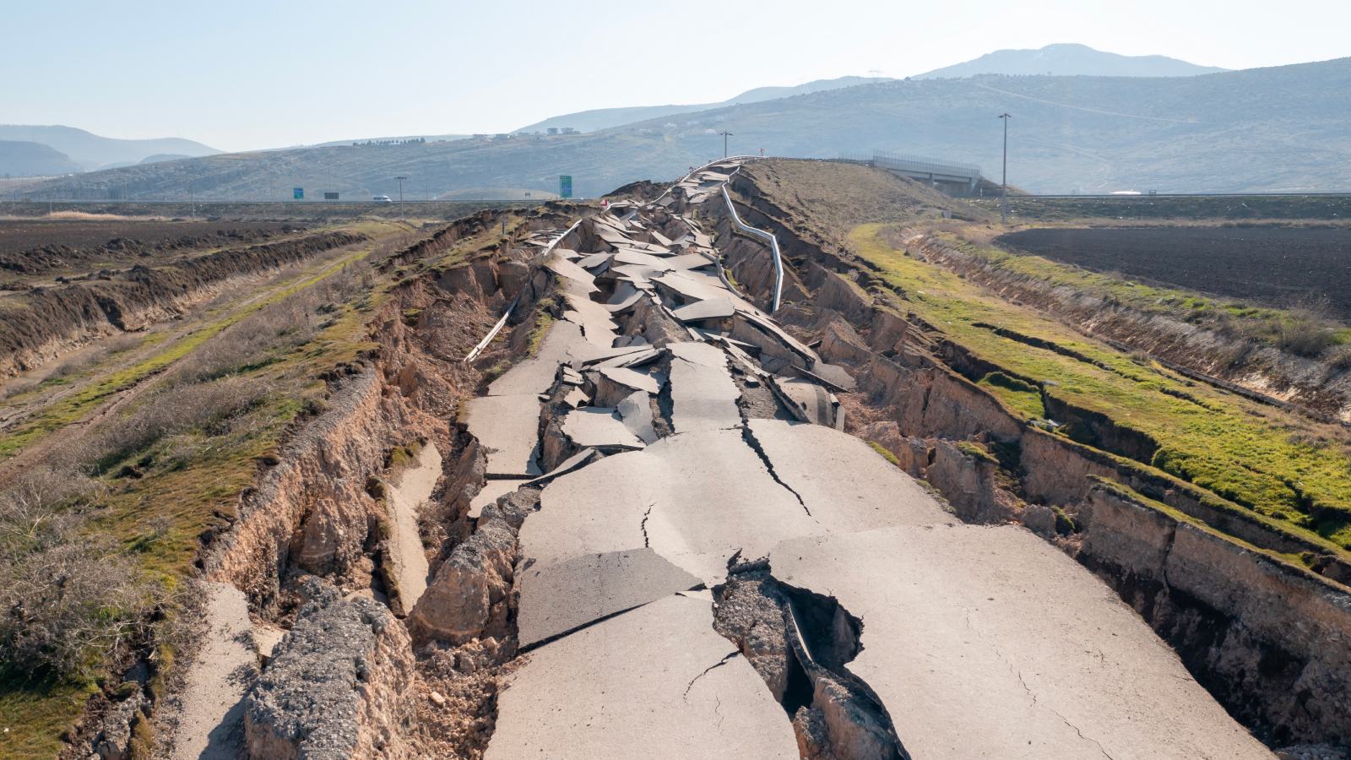

Distribution of Earthquakes
Sai Ayukkta Radhakrishnan​

Slide 2
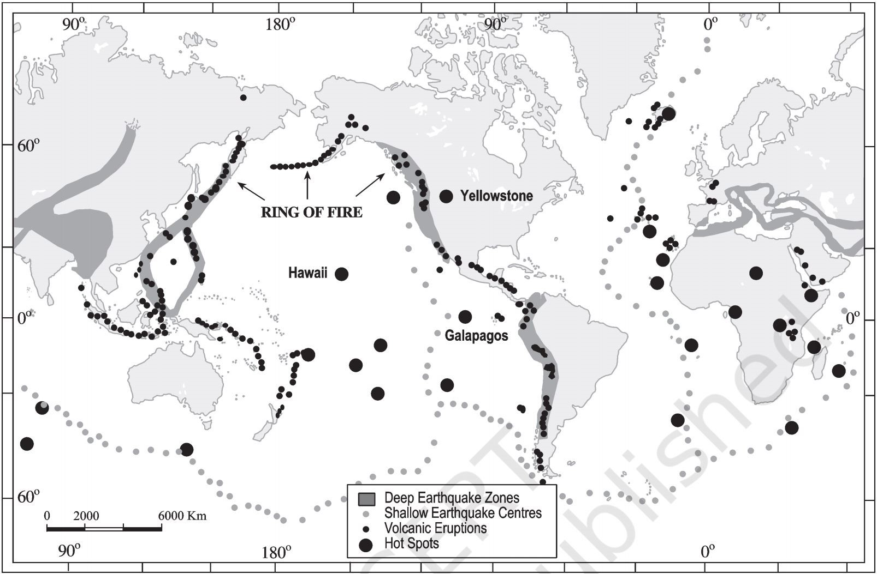
Agenda
Introduction
Circum-Pacific belt
Mid-Continental belt
Mid-Atlantic Ridge belt
Conclusion

Slide 3
Introduction
No part of the Earth is free from earthquakes.
But in some areas, earthquakes occur more frequently.
The main earthquake belts on the Earth are as under:
Circum-Pacific belt
Mid-Continental belt
Mid-Atlantic Ridge belt

Slide 4
Circum-Pacific belt
The Circum-Pacific belt includes the coastal margins of North America, South America and east Asia.
These regions account for about 65 per cent of the total earthquakes of the world.
This belt coincides with the Pacific Ring of Fire.

Slide 5
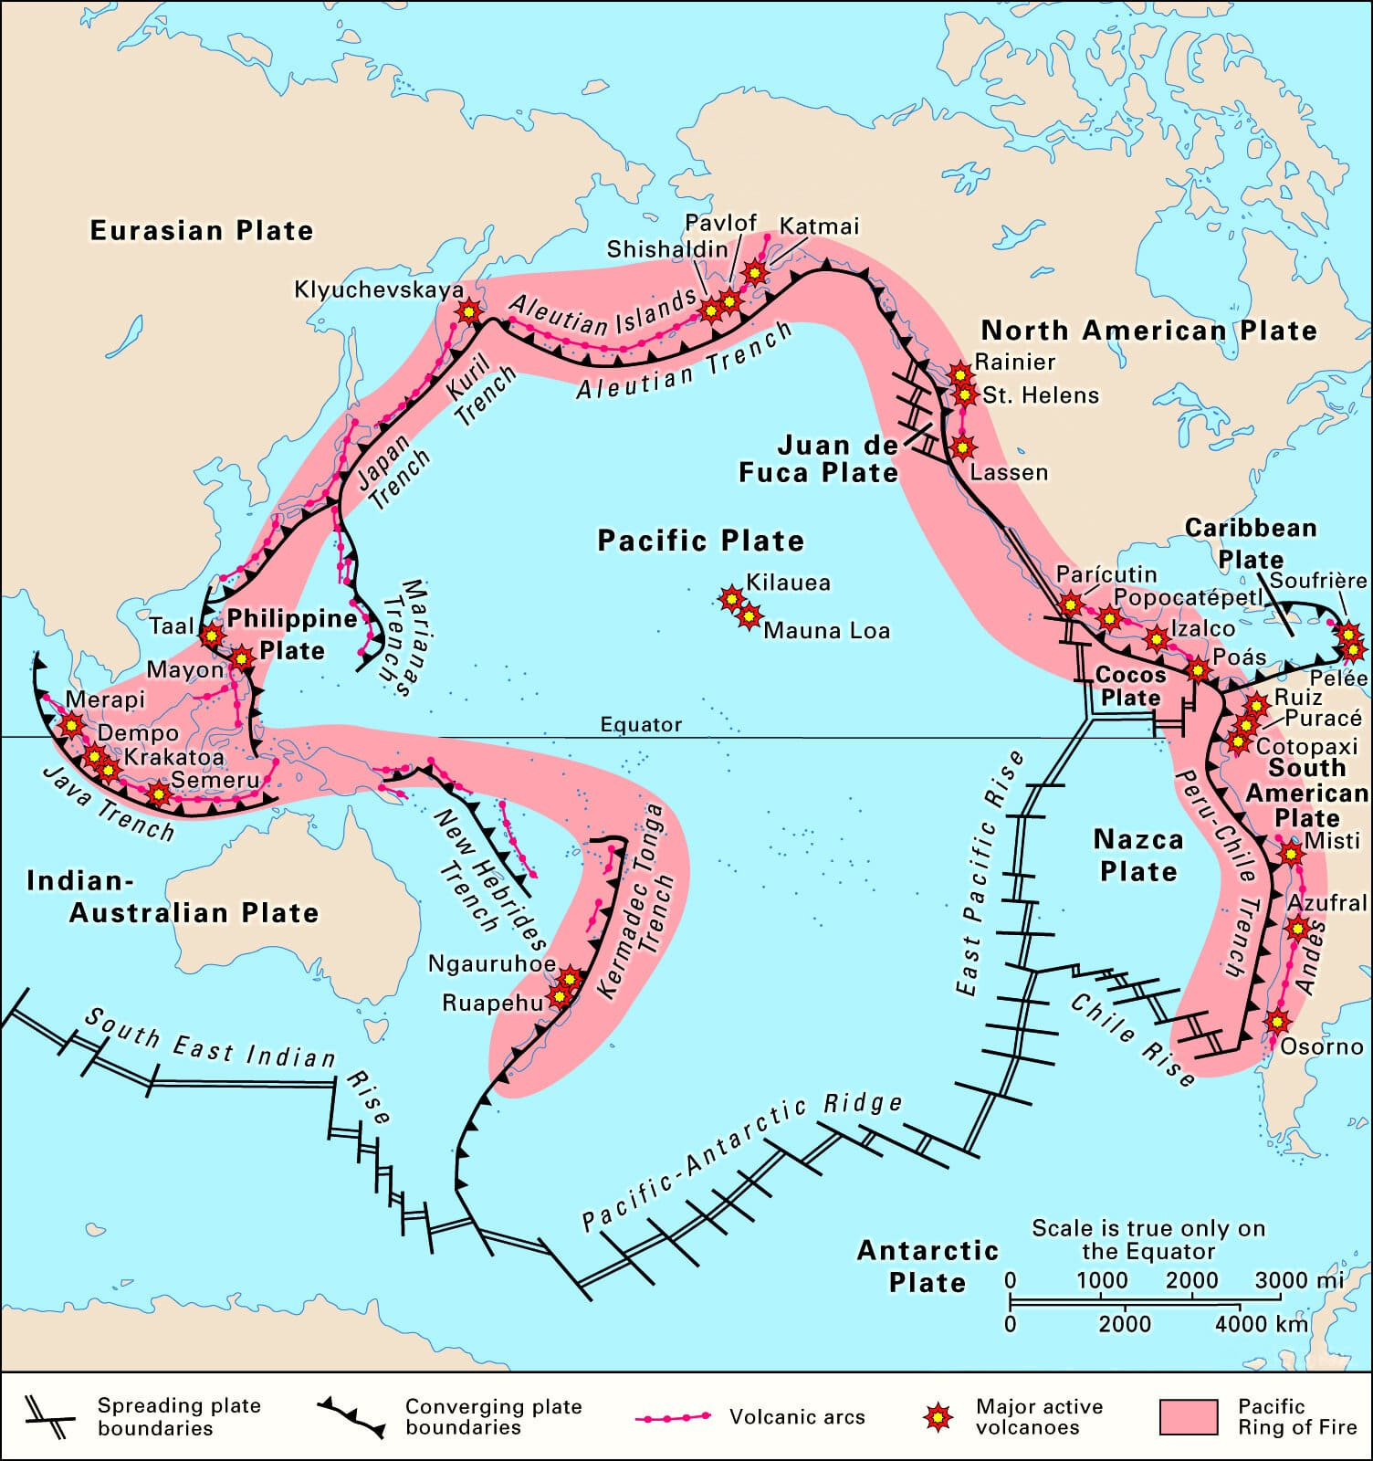

Slide 6
Mid-Continental belt
The Mid-Continental belt includes the Alpine mountains, Mediterranean Sea, northern and eastern Africa and the Himalayas.
About 25 per cent of the seismic events are recorded here.

Slide 7
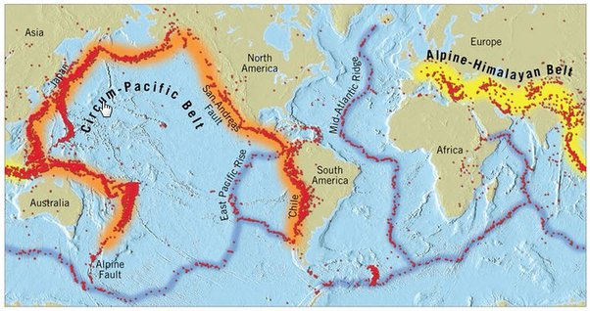

Slide 8
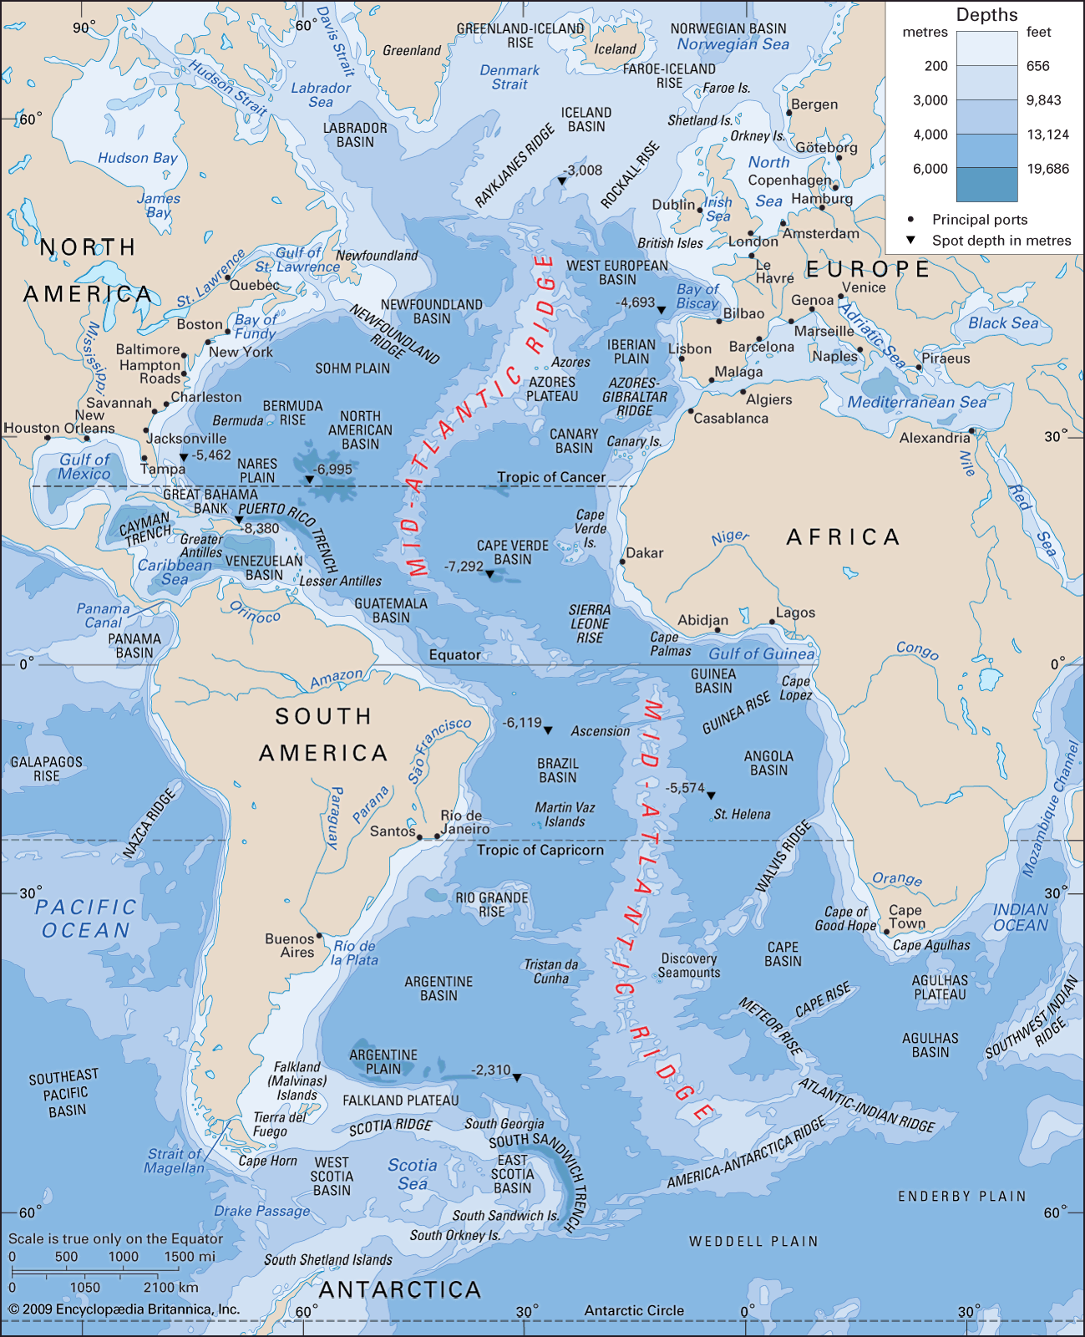
Mid-Atlantic Ridge belt
The Mid-Atlantic Ridge belt includes the Mid-Atlantic ridge and the adjoining islands.
It records moderate earthquakes which are caused due to the moving of the lithospheric plates in opposite directions.
The earthquake belt in India is mainly confined to the Himalayan region and the Ganga-Brahmaputra valley.
About two-thirds of India is earthquake prone.
In the last 50 years, earthquake tremors have been experienced even in the Deccan plateau which was considered relatively safe and free from earthquakes.
The Bureau of Indian Standards has divided India into five earthquake zones.

Slide 9
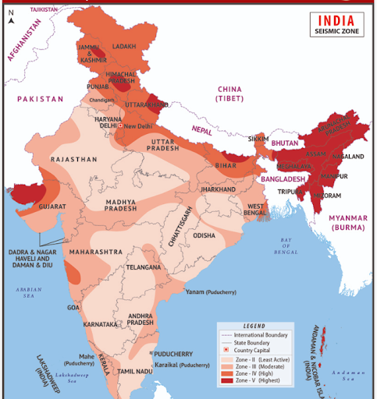

Slide 10



Conclusion

Slide 11
Thank You
Sai Ayukkta Radhakrishnan​

